Slide 1

Final Project
Aksaraphak pandey

Slide 2
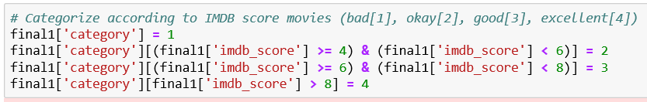
Categorization
Creating categories for the movies based on their IMDb score. These four categories are Bad if the score is less than four(<4), Okay if the score is between four to six (4-6), Good (6-8), and Excellent is if the score is between eight to ten (8-10).

Slide 3

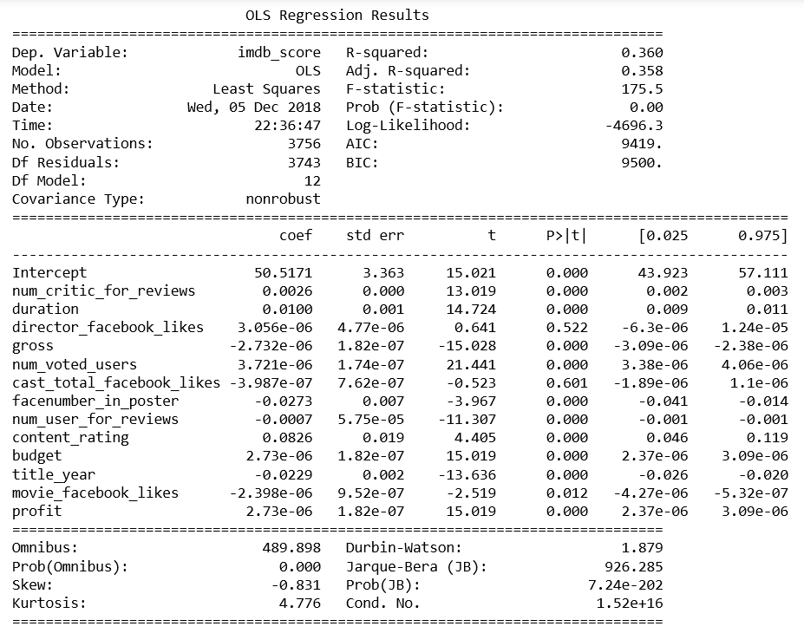
Regression
Simple Regression:
The model include the variable factoring in predicting the success of a movie

Slide 4
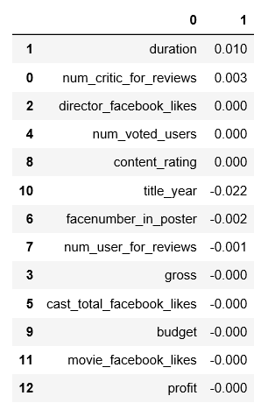
Lasso:
The variables are ordered from most significant variables to least. The most significant variables in the lasso model are duration and Numbers of critics for reviews.

Slide 5
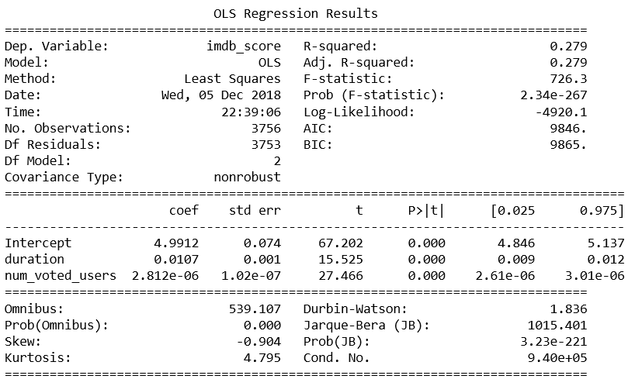
F Selection
The F Selection model used duration and number of users who voted determines the best predictor. it is based on overall popularity.

Slide 6

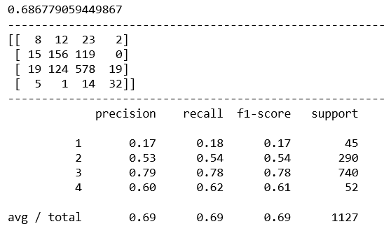
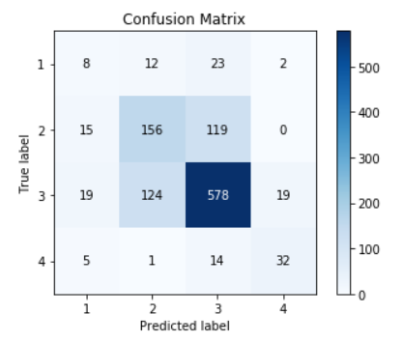
Decision Tree:
The matrix shows that ‘good’ movies were most often correct.
The model is 69% accurate in placing movies in the correct category, which is an average on the high side of precision.

Slide 7
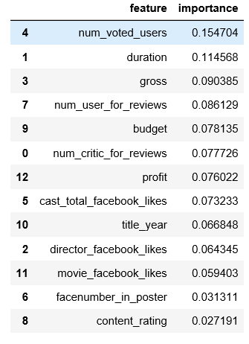
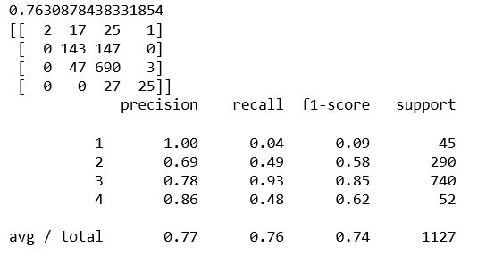
Random Forest
With 500 iterations, this model has an accuracy of 79.2% of prediction. the most important variables as number of users who voted and the duration of the film.

Slide 8
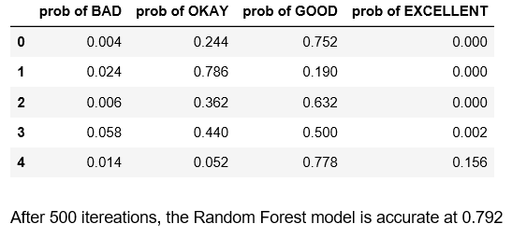

Slide 9
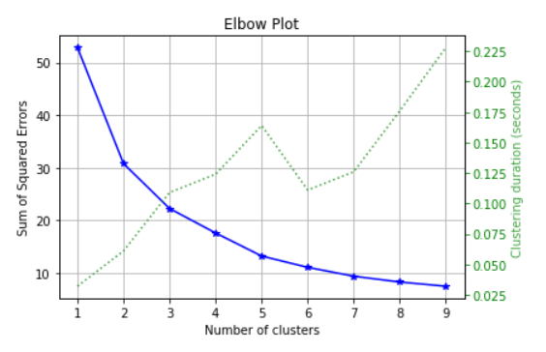
Clustering
the ideal number of clusters is 4 to be able to place movies in the correct category

Slide 10
Conclusion
The 2 most important variables for the prediction of a movie’s success
- Amount of users who voted
- Duration of the movie

